Slide 1
Ticket Agency System
Team 5
Jixiao Yang 001444344
Xiaoge Zhang 001409334
Junyi Fang 001495265
Notes:
Our project is a ticket agency system

Slide 2
1
PROJECT OBJECTIVE
Notes:
First I’d like to talk about the project objective

Slide 3
Project Objective
Project Description:
A ticket agency system that allows a large number of users to buy tickets for at least three events concurrently, with numbers of tickets ranging from 1,000 to 100,000
Objective
The system can handle 1000 concurrent user requests in a short time and respond without error
Build the user interface that enable users to select events, purchase tickets and check their purchase histories; enable the ticket owner to check the event ticket details and ticket purchasing information
Notes:
We developed a ticket agency system that allows a large number of users to buy tickets for at least three events concurrently, with numbers of tickets ranging from 1,000 to 100,000
The objective of our system is to can handle 1000 concurrent user requests in a short time and respond without error
Build the user interface that enable users to select events, purchase tickets and check their purchase histories; enable the ticket owner to check the event ticket details and ticket purchasing information

Slide 4
2
PROJECT
IMPLEMENTATION
Notes:
Next, let’s have a look at our project implementation

Slide 5
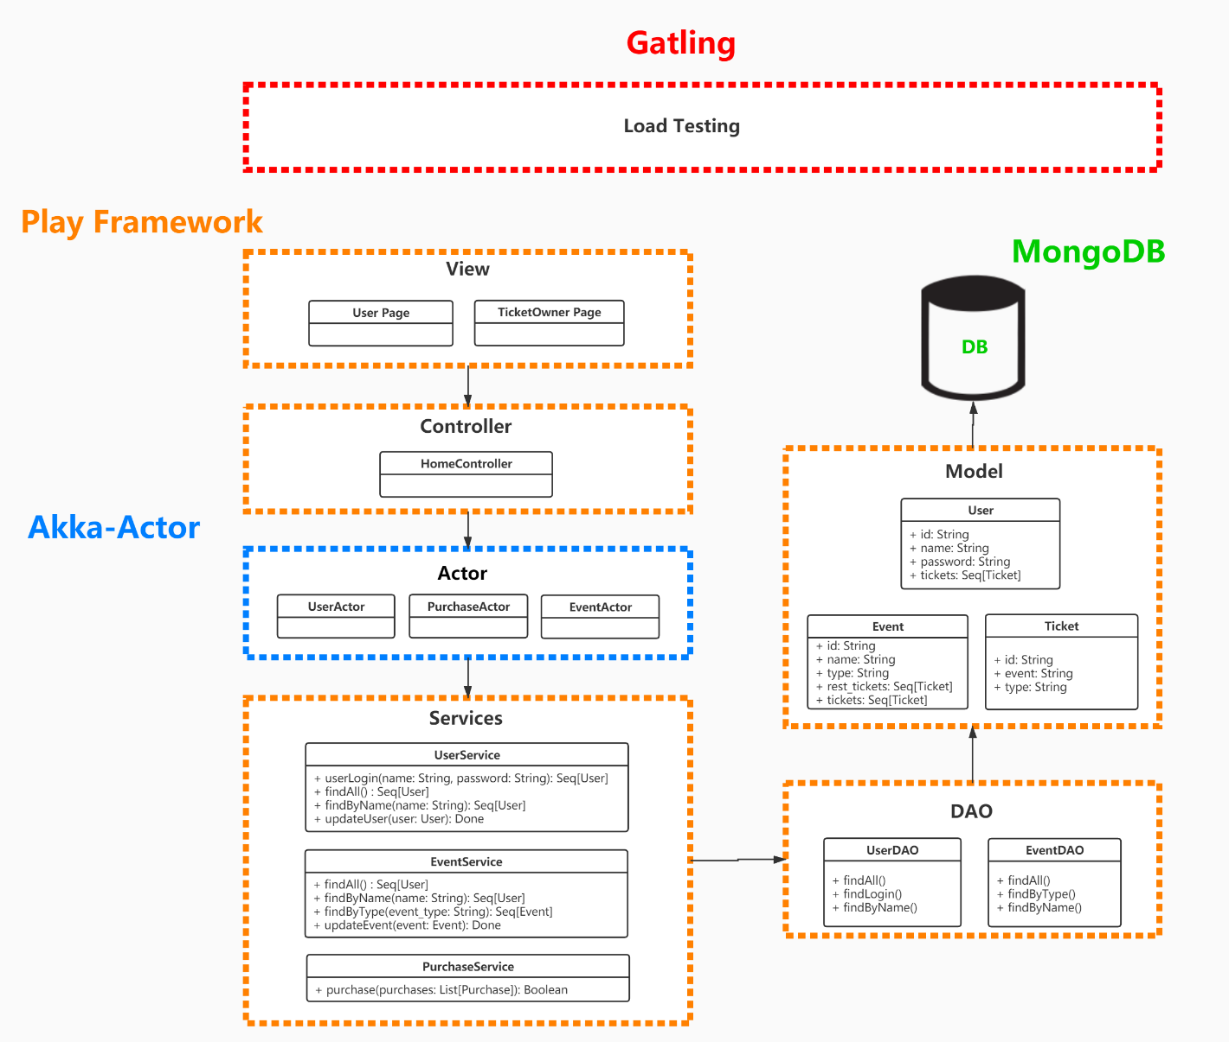
Notes:
We developed the system using playframe work to follow the MVC structure. We use akka actor model to handle the concurrency of user request in our system. For data accessing and storage, we used MongoDB and create apis in DAO layer to update and retrieve the data

Slide 6
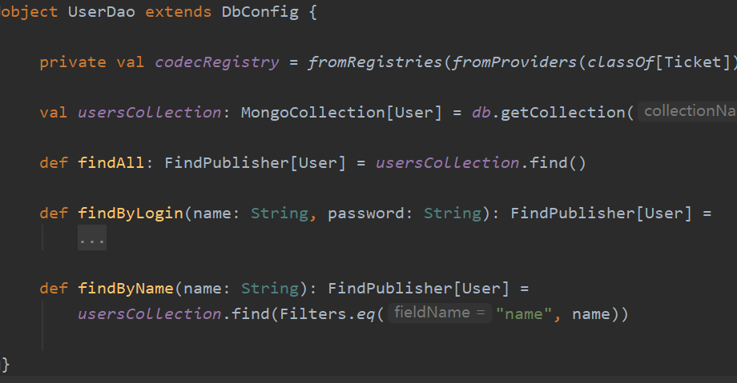
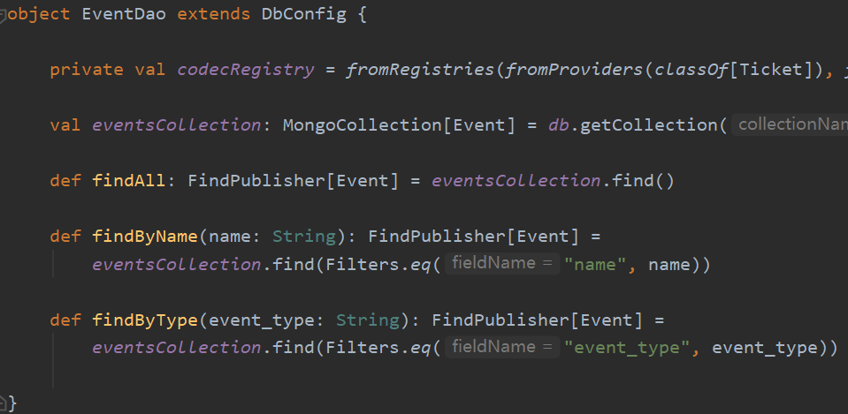
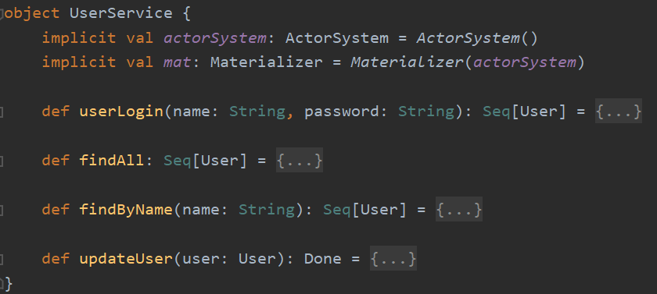
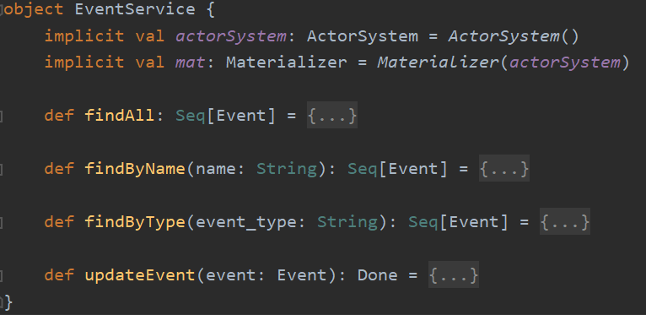
Project Implementation - Service
Call functions from DAO
Notes:
Going into some implementation detail of our project, in the service layer, we created the UserService and EventService to call the apis from DAO layer to fetch the user and ticket data

Slide 7
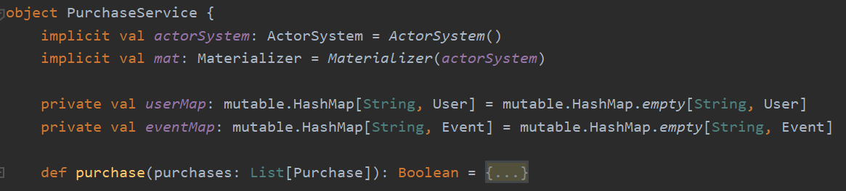
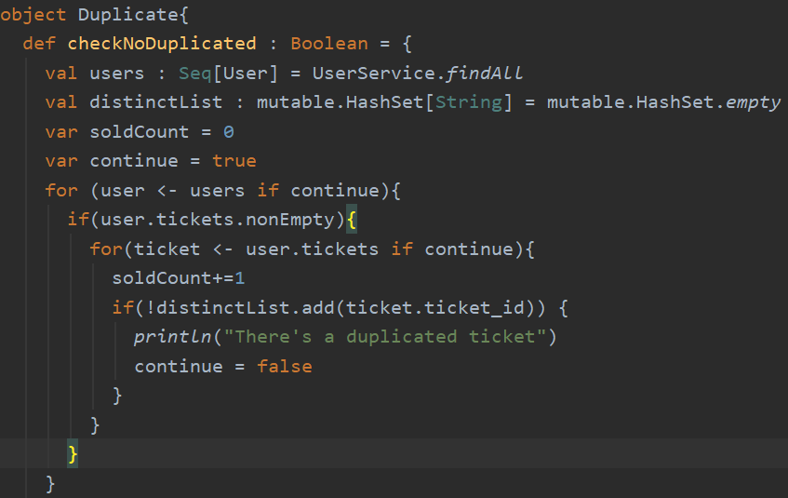
Project Implementation - Service
Check if multiple users get a same ticket
Notes:
Also, we created purchaseservice to
We created the Duplicate service to check if multiple users are getting the same ticket. And make sure one ticket can only be sold once.

Slide 8
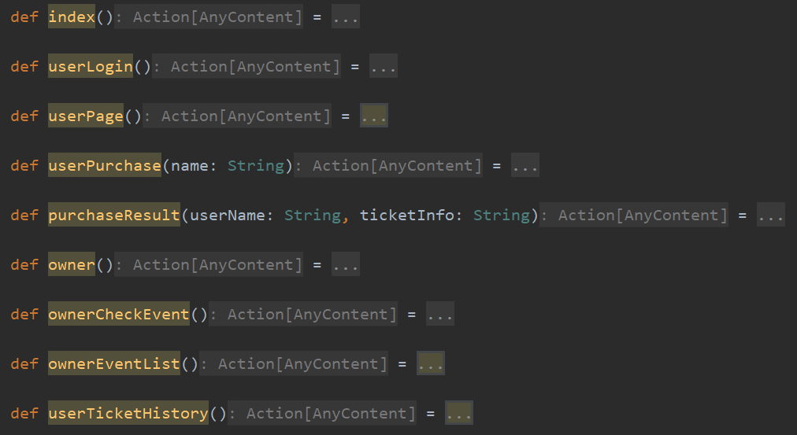
Project Implementation - Controller
Call by the view page as routes to switch between different pages
Notes:
The methods defined in controller layer are called by the view page as routes to switch between different pages

Slide 9
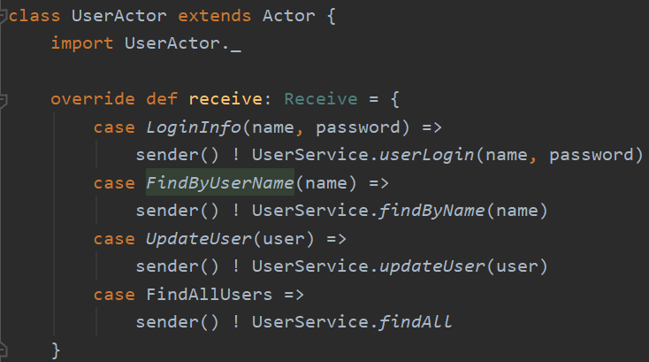

Project Implementation - Actor
Manipulate by the controller to concurrently complete actions defined in services
Notes:
We created 3 actors in our system to handle the concurrency, which is UserActor, EventActor and PurchaseActor. The actors are Manipulated by the controller to concurrently complete actions defined in services like login, finduserbyname and so on

Slide 10
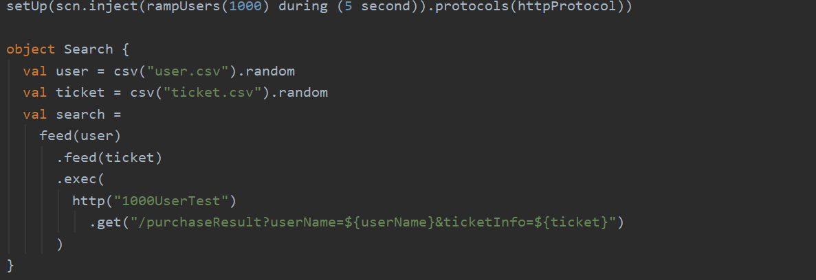
Project Implementation – Load Testing
Gatling
Notes:
To do the load testing for our system, we used gatling (which is a load testing tool for scala) to simulate an amount of user requests and generate testing reports

Slide 11
3
USE CASE IMPLEMENTATION
Notes:
The next part is about the use case implementation of our project

Slide 12
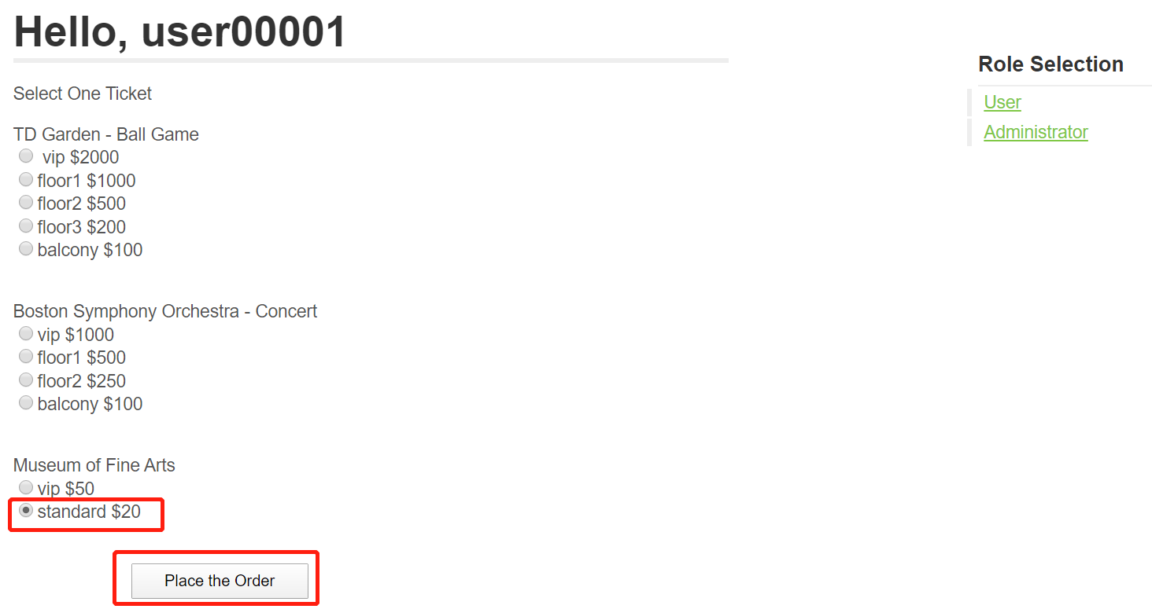
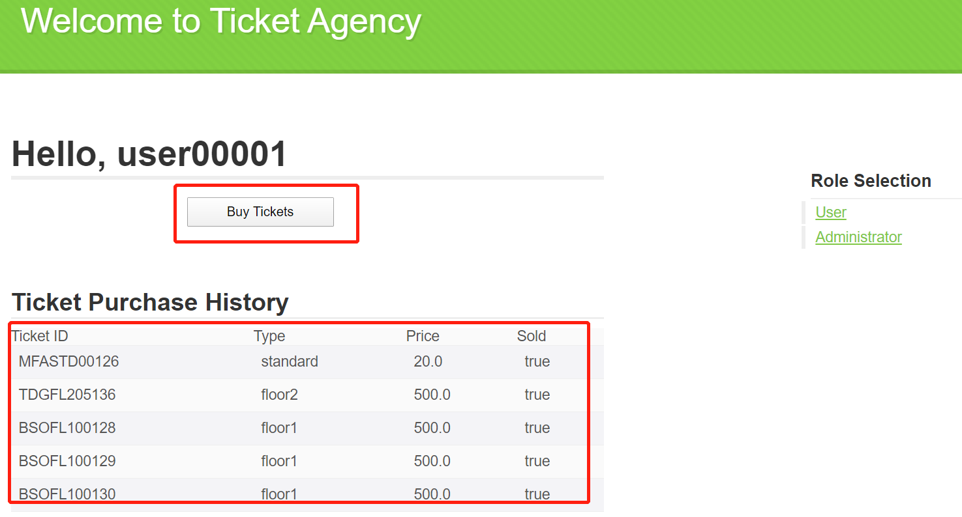
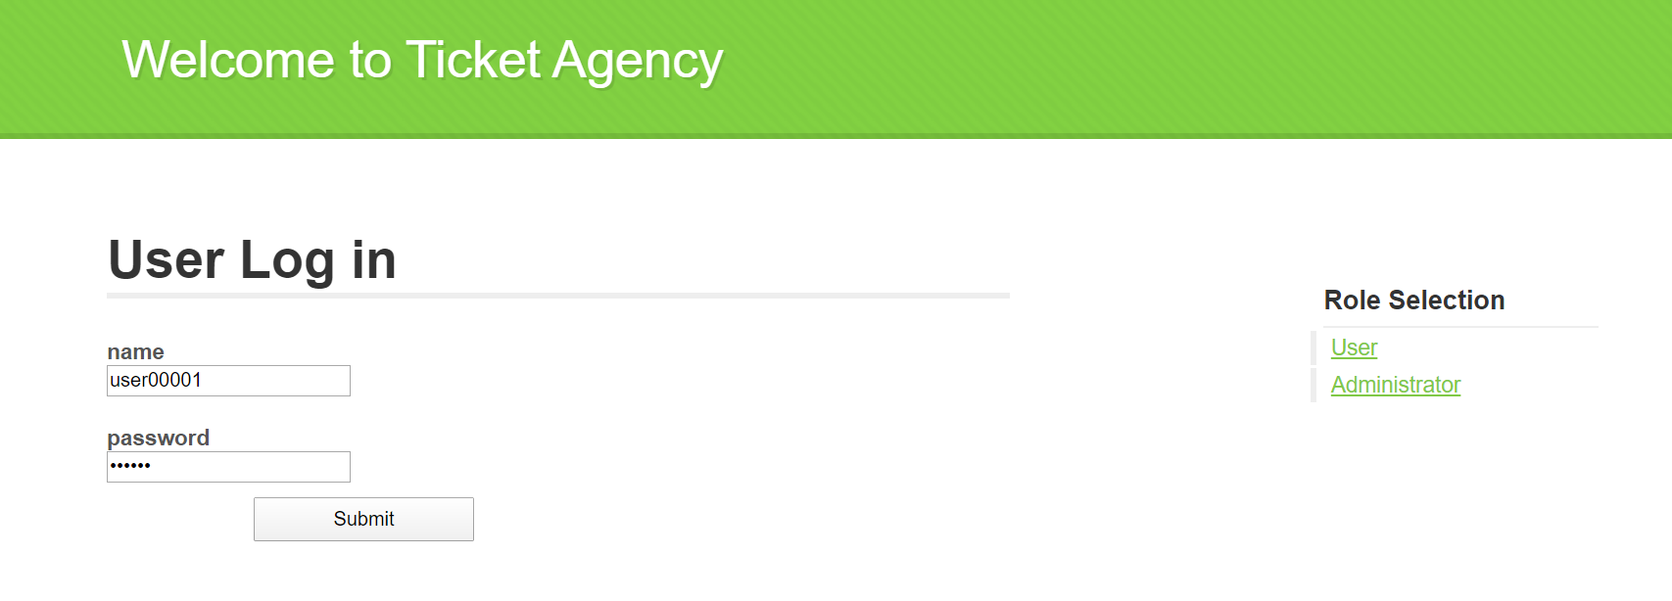
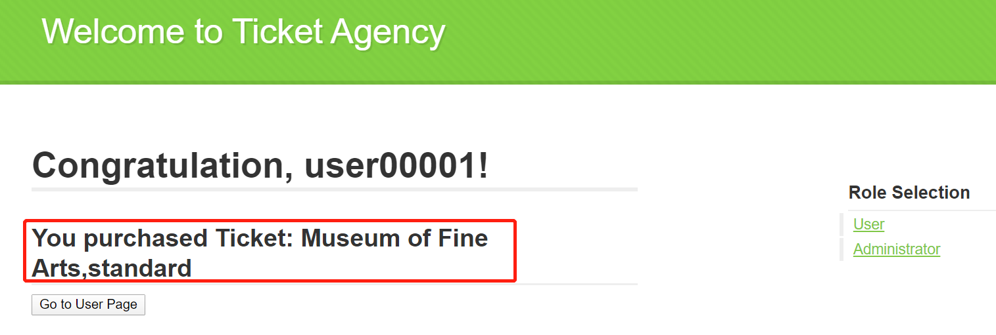
Use Case Implementation —— User
Action 1: Purchase tickets
Action 2: Check purchase history
Notes:
In our proposal, we defined two actors in our system, the first one is user. There are two actions for user, which is purchasing ticket for a certain event; and checking his purchase history

Slide 13
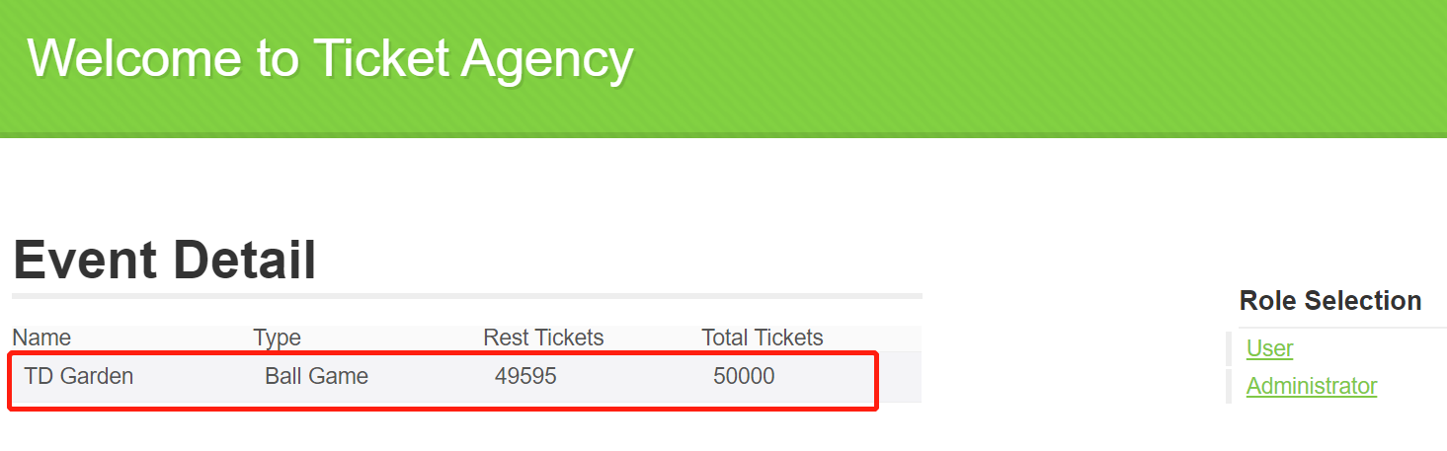
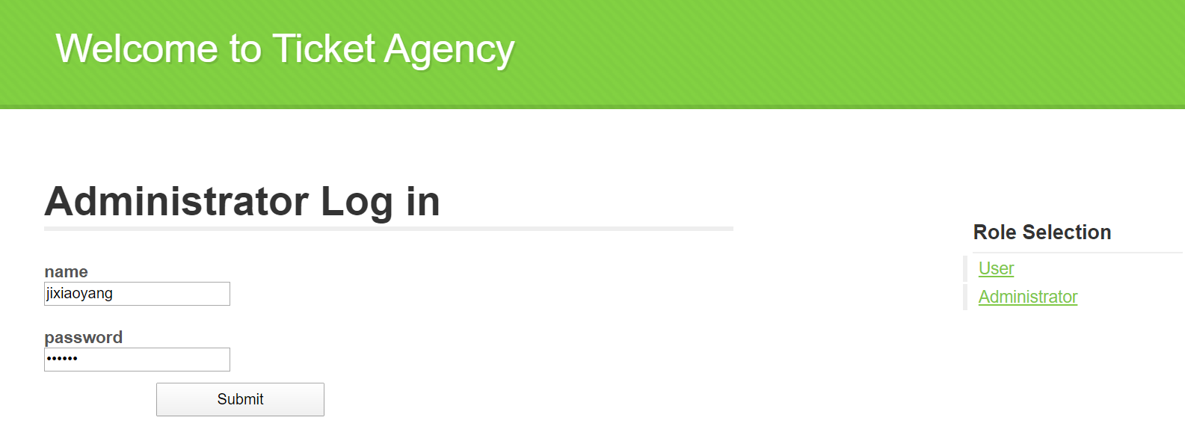
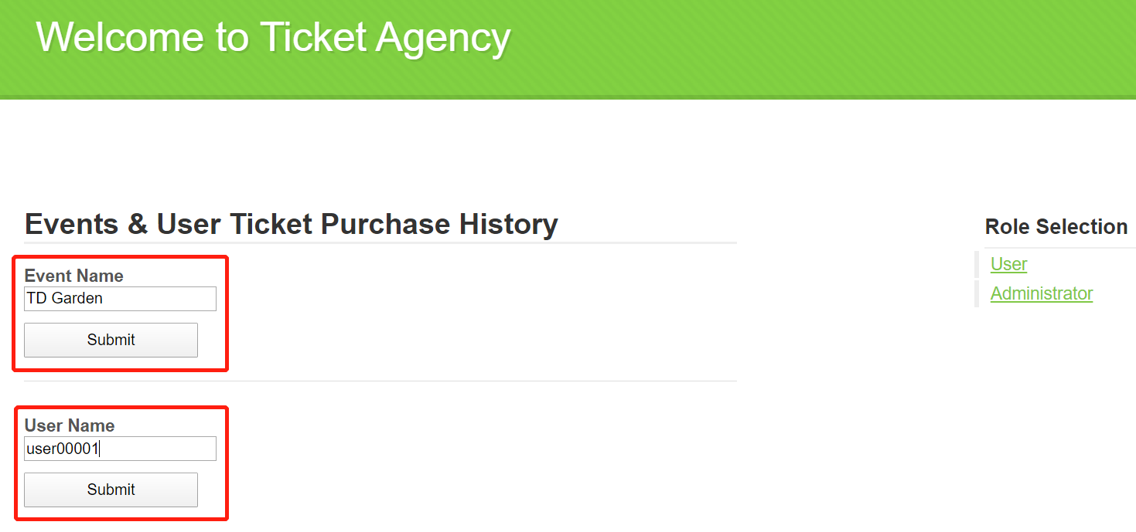
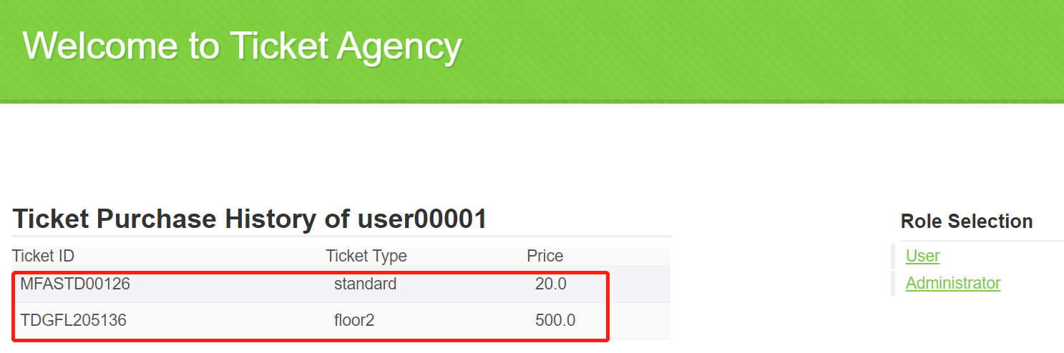
Use Case Implementation —— Owner
Action 1: Check event detail
Action 2: Check user purchase history
Notes:
The other actor in the system is ticket owner, which has two actions: checking event detail and the user purchase history

Slide 14
4
UNIT TEST
Notes:
The next part is the unit test result of our system

Slide 15
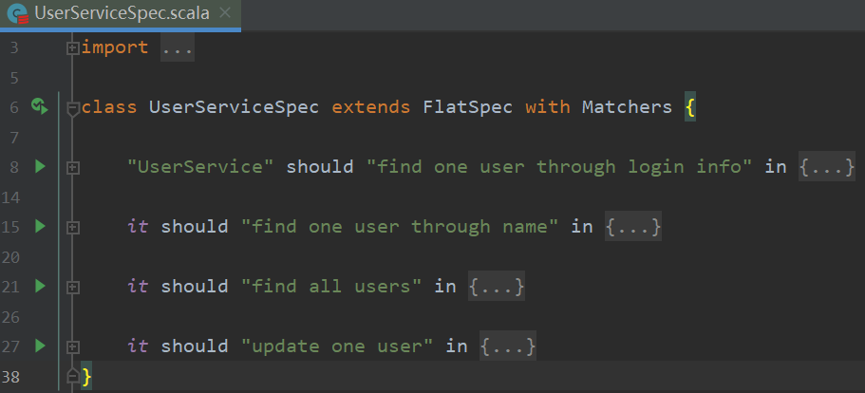
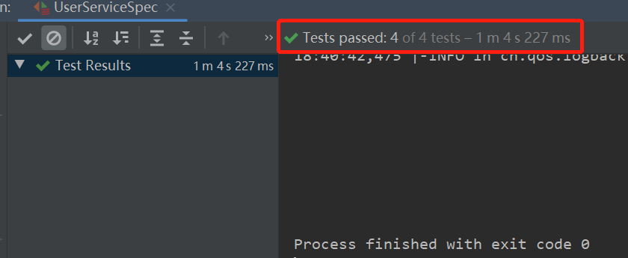
Unit Test Results
UserServiceSpec: Unit test for all functions in UserService
Notes:
We did unit tests for all of the main services in the system to make sure the entire flow is correct

Slide 16
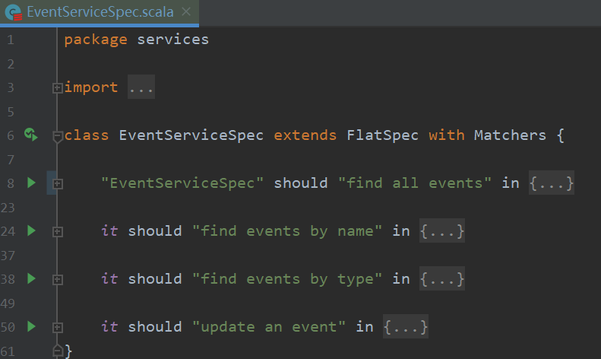
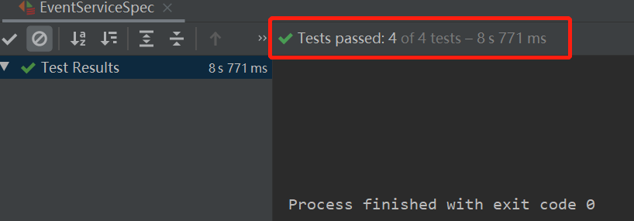
Unit Test Results
EventServiceSpec: Unit test for all functions in EventService

Slide 17
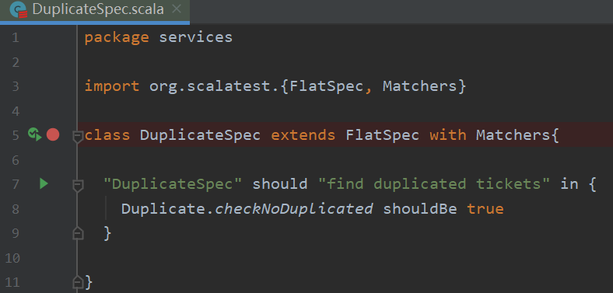
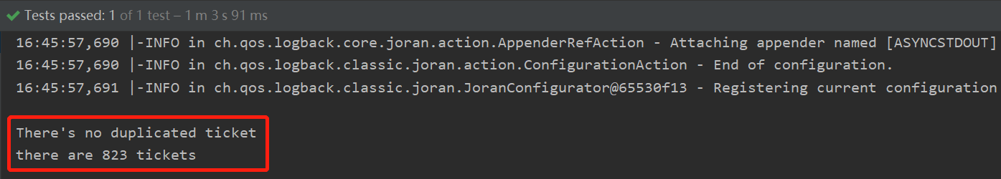
Unit Test Results
DuplicateSpec: Unit test for checking duplicate ticket purchasing amoung all users
Notes:
We also created a test to make sure there’s no a single ticket been sold more than once, which means users can’t purchase the same ticket

Slide 18
5
CRITERIA & RESULTS
Notes:
The next part is the acceptance criteria and the result of our implementation

Slide 19
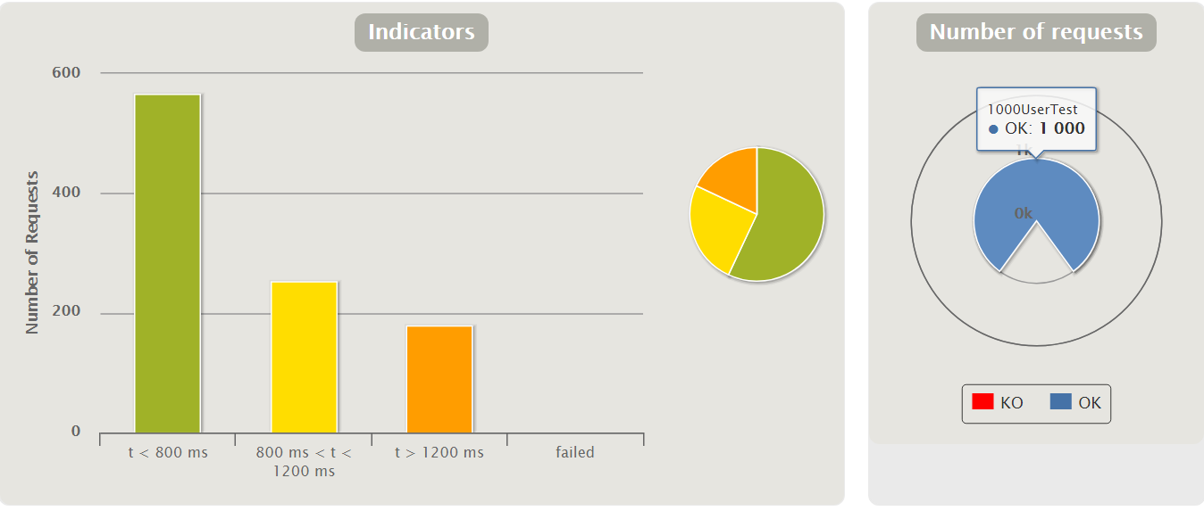
Criteria & Results
1,000 user: 100% request success rate
Criteria 1:
Allow 1,000 users to purchase tickets concurrently without any conflict (make sure every ticket can not be sold more than once)
One ticket sold for only once
Notes:
In order to meet the criteria of our system, we used gatling to do the load testing.
The first criteria we made in our proposal is to Allow 1,000 users to purchase tickets concurrently without any conflict (make sure every ticket can not be sold more than once)
According to the report of our load testing, We can we got a 100% success rate for 1000 concurrent user requests. None of the requests failed. And after running our duplicate test, there is no duplicately sold ticket

Slide 20
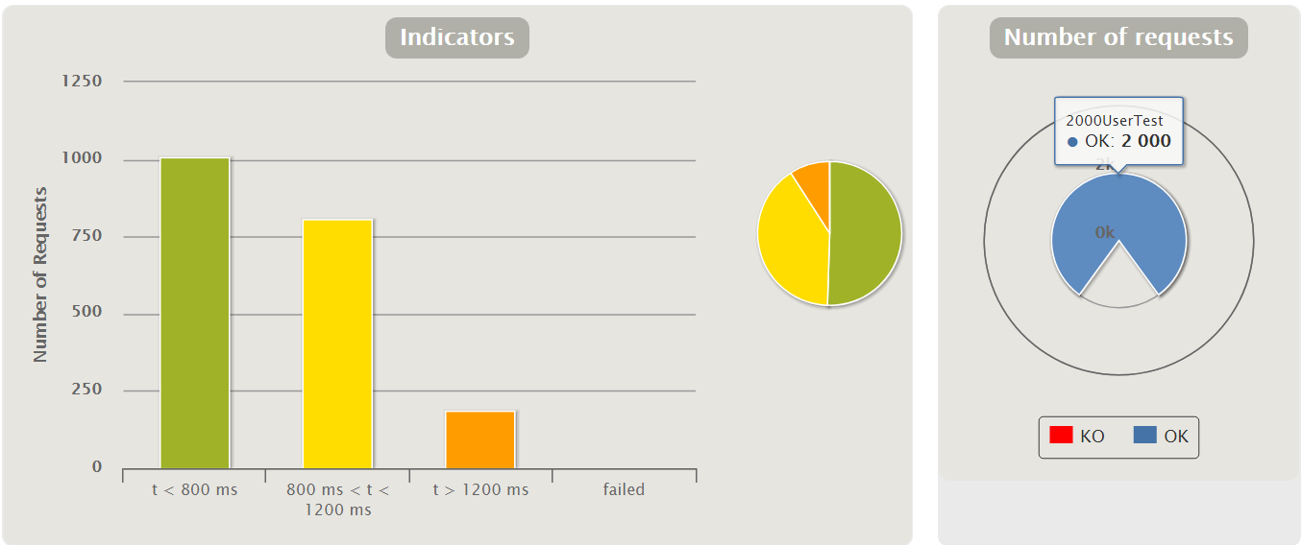
Criteria & Results
Criteria 1:
Allow 1,000 users to purchase tickets concurrently without any conflict (make sure every ticket can not be sold more than once)
2,000 user: 100% request success rate
Notes:
We also test for 2000 user and 4000 users, they all got 100% success and no conflicts

Slide 21
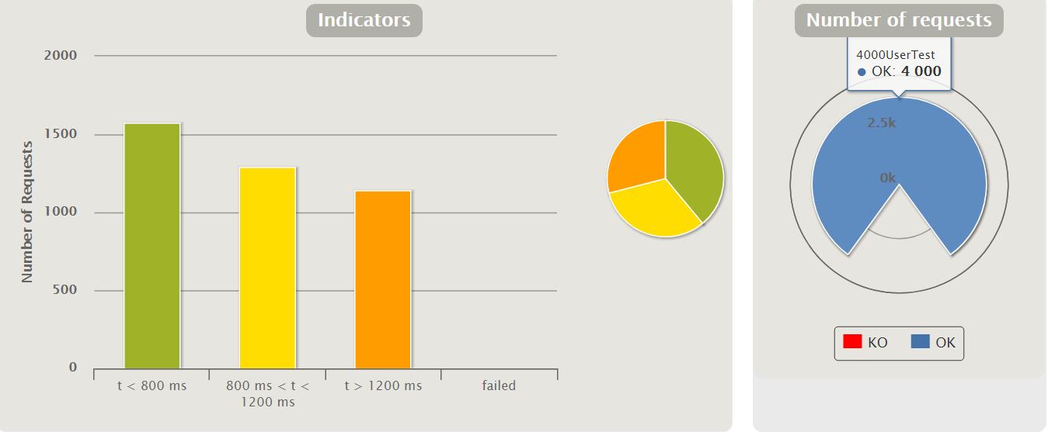
Criteria & Results
4,000 user: 100% request success rate
Criteria 1:
Allow 1,000 users to purchase tickets concurrently without any conflict (make sure every ticket can not be sold more than once)

Slide 22
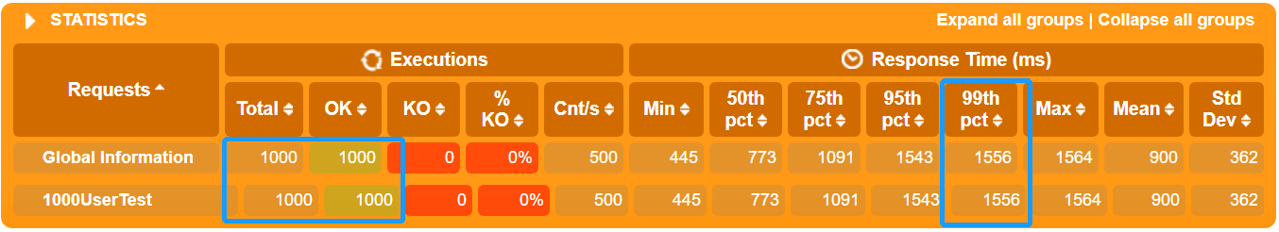
Criteria & Results
Criteria 2: Make sure 90% of user requests can be responded within 4 seconds
1000 users: 100%
Notes:
The second criteria is to Make sure 90% of user requests can be responded within 4 seconds
We can see from the report that For 1000 concurrent user request, 100% of the requests are responded with 1556 ms which is 1.5 seconds, which meets our expectations.

Slide 23
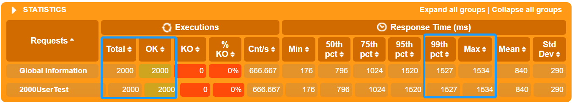
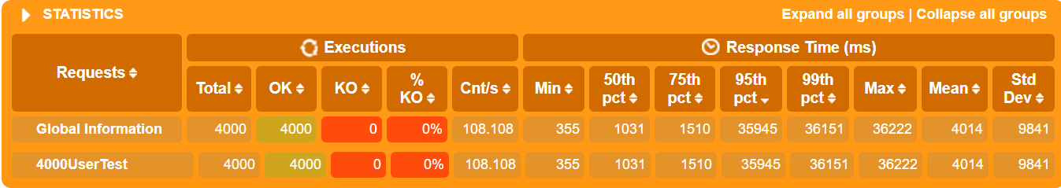
Criteria & Results
Criteria 2: Make sure 90% of user requests can be responded within 4 seconds
2000 users: 100%
4000 users: 91%

Slide 24
6
CONCLUSION
Notes:
The last part is the conclusion of our project

Slide 25
Conclusion
Neat User Interface for Users & Ticket Owners
Purchase tickets for different events
Check Ticket History
Check Event Detail
Concurrent Ticket Query & Purchase with No Conflict
100% success request rate for 1000 users to purchase tickets concurrently
A ticket can only be sold once
High Performance of User Query
1.5 seconds for 100% percent of 1,000 – 2,000 user queries
1.5 seconds for 91% percent of 4,000 user queries
Notes:
IN our project ,we created a ticket agency system with Neat User Interface for both Users & Ticket Owners. The users can Purchase tickets for different event and Check their purchase History; the ticket owner can check the event and ticket detail as well as check any user’s purchase history.
We implemented 100% success request rate for 4000 users to purchase tickets concurrently, and make sure a ticket can only be sold once so that the users can buy tickets with no conflict
Also, we implement 1.5 seconds for 100% percent of 1,000 – 2,000 user queries
1.5 seconds for 91% percent of 4,000 user queries
Which fulfill the expectation in our proposal

Slide 26
THANK YOU

